Slide 1
Mendelian Randomization
NHSG June 21, 2023
Gudmundur Einarsson & Joëlle Pasman

Slide 2


Joëlle Pasman
PhD from Radboud University Nijmegen, Netherlands
Genetics and gene-environment interplay
Substance use
Post doc at Karolinska Institute Stockholm, Sweden
Genetics and epidemiology of depression

Slide 3

Gudmundur Einarsson
PhD from Technical University of Denmark (2014-2018)
Statistics and mathematical modelling
Projects with deCODE genetics
Researcher at deCODE since 2020

Slide 4
Outline
9.00-11.00 Plenary
NHSG - MR workshop plenary
11.00-11.30 Coffee
11.30-12.30 Basics & R tutorial
NHSG - MR workshop part 2_JP – 15 min
MR-Tutorial_Est_I.Rmd – 45 min
12.30-13.30 Lunch
13.30-14.30 Advanced methods & R tutorial
MR-Tutorial_Est_II.Rmd - 30 min
NHSG - MR workshop part 3_GE - 20 min
Wrap up – 10 min

Slide 5
Outline
Brief history of Mendelian Randomization (MR)
Assumptions for MR analysis
Checking assumptions (trying to -> hard or impossible)
Reverse causality
Does the variant go through the exposure?
MR versus other methods

Slide 6
History
Mendelian Randomization is a method rooted in genetics
Name directly inspired from Mendel’s rules of inheritance
Law of segregation
Gametes (Sex cells) only have a single copy of a gene
Law of independent assortment
A pair of traits segregates independently of another pair during gamete formation. Different traits get equal opportunity to occur together.
Population genetics started in early 20th century
First genetics-disease link established in 1949
Linus Pauling and sickle cell anaemia
DNA discovered in 1953

Slide 7
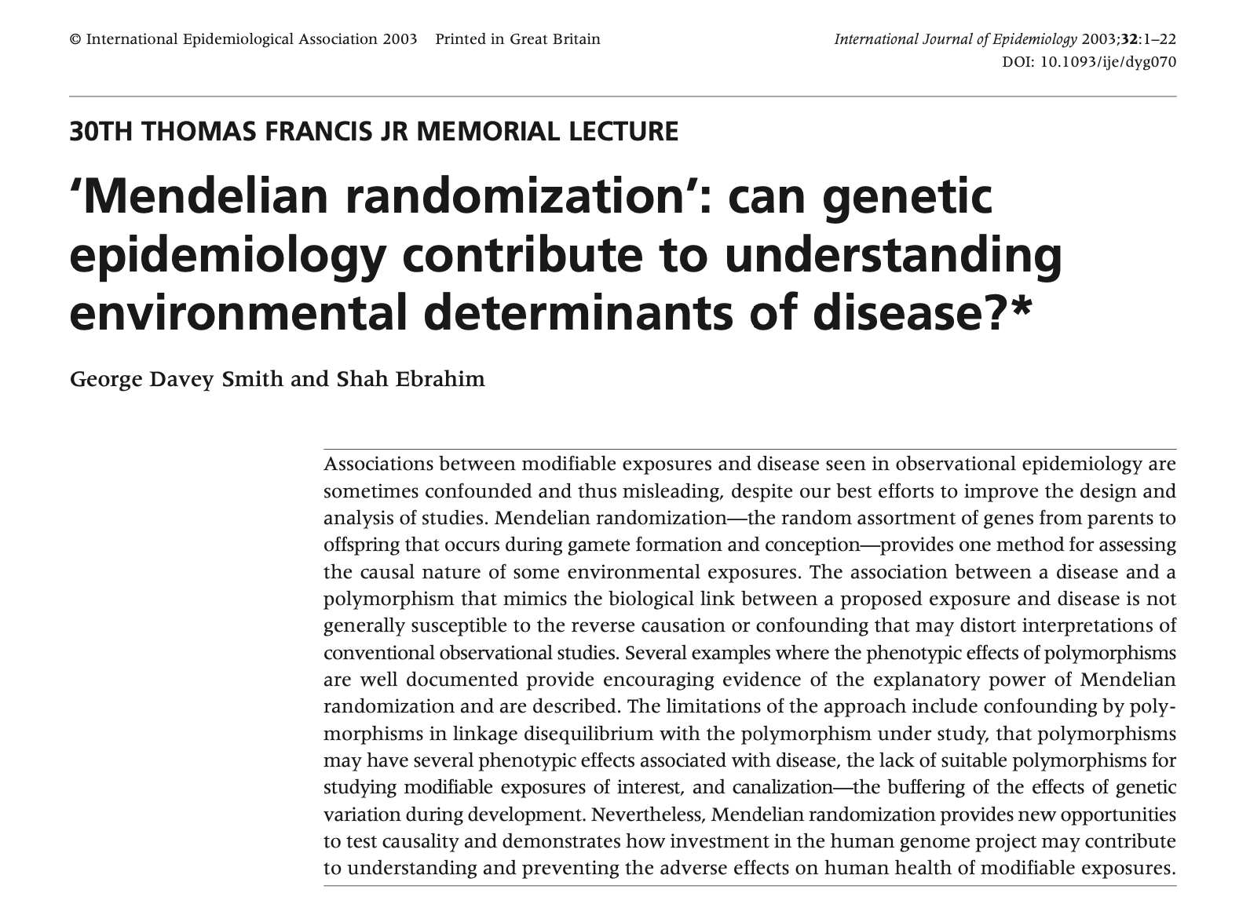
History
Human Genome Project started in 1990
Early mentions of MR in the 2003 paper ->
Interesting that they specifically mention confounding by polymorphisms in linkage
Focus more on single variants

Slide 8
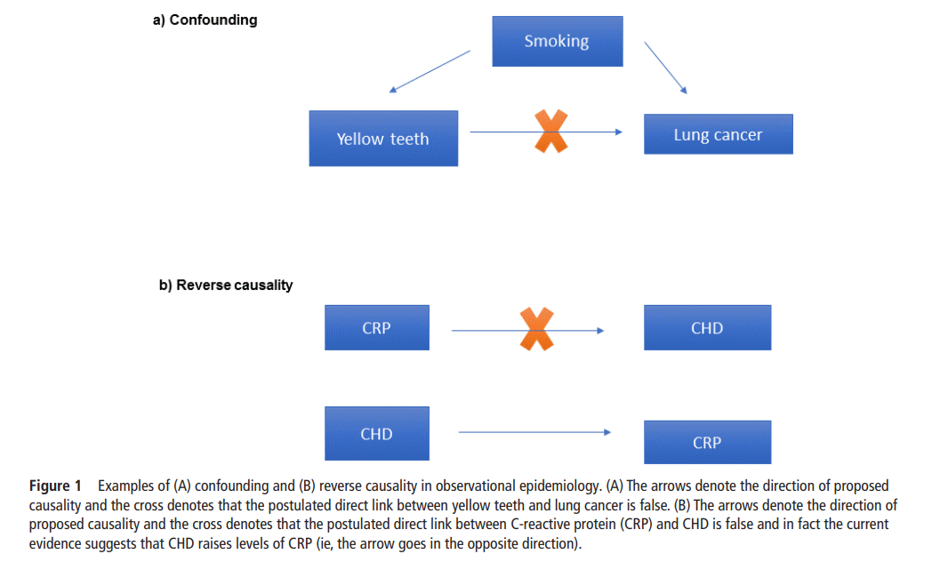
Correlation is not causation!
We cannot proof causality with results from observational data
The gold-standard way is a randomised clinical trial (RCT)
An experiment!
Bennet and Holmes 2017 Heart
https://heart.bmj.com/content/heartjnl/103/18/1400.full.pdf

Slide 9
How do we conduct an experiment?
We cannot manually account for all confounding factors
We cannot even know them beforehand
Randomization is a tool to solve this
We control the treatment difference between two randomized groups
We can measure the effect of treatment independent of confounders
Conditioned on the population/environment we are working with
Revolutionized in agriculture in the beginning of 20th century
How do experiments relate to genetics?
Genetic variants represent natural experiments

Slide 10
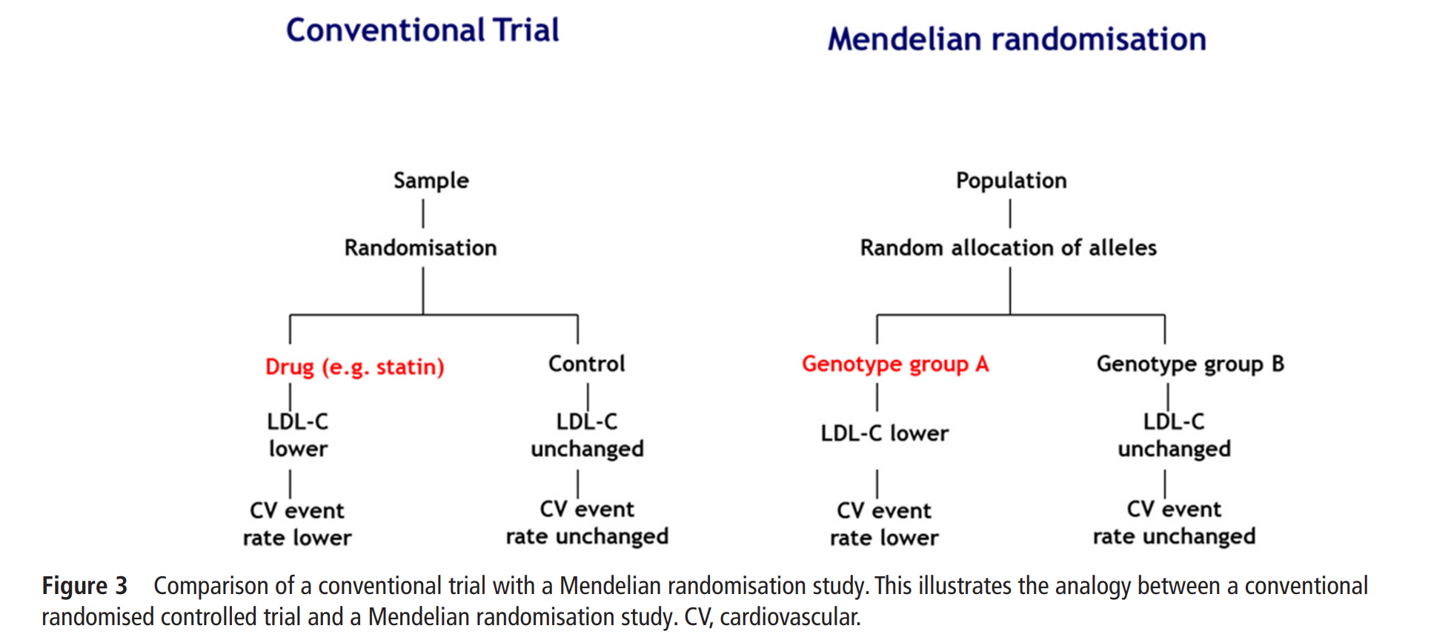
MR vs RCT
Bennet and Holmes 2017 Heart;
https://heart.bmj.com/content/heartjnl/103/18/1400.full.pdf

Slide 11
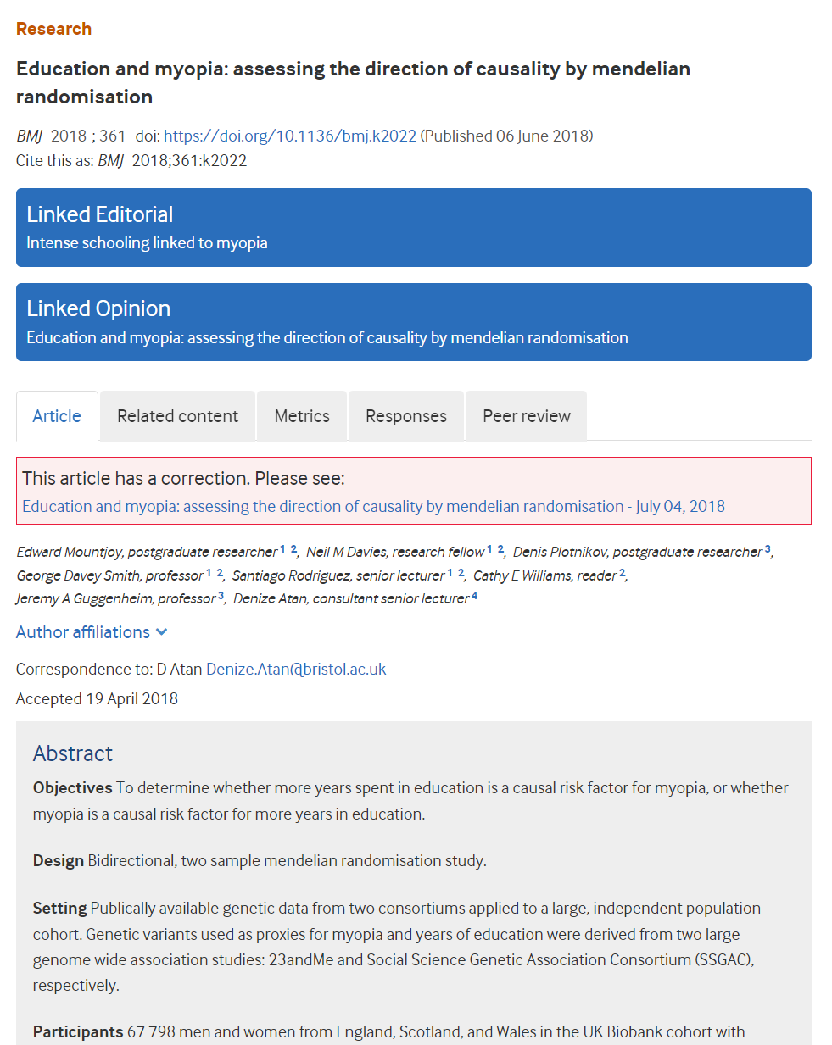
Benefits of MR
Can test things that are impossible to do in a trial
Can check results before doing a trial
Famous example with HDL cholesterol and coronary artery disease (CAD)
Lowering LDL reduces risk of CAD
LDL and HDL are correlated
Mountjoy et al.
https://www.bmj.com/content/361/bmj.k2022.long

Slide 12
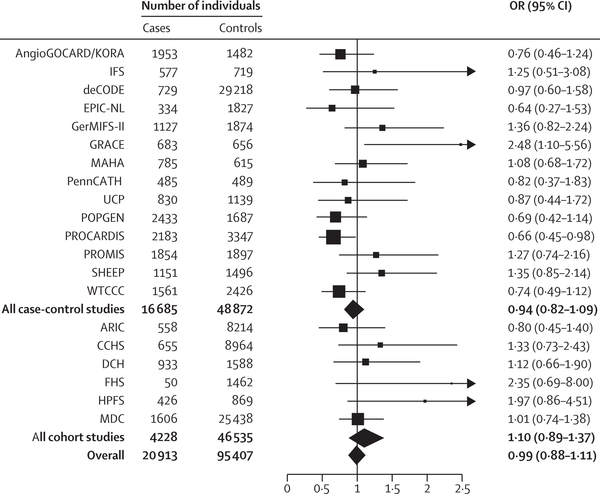
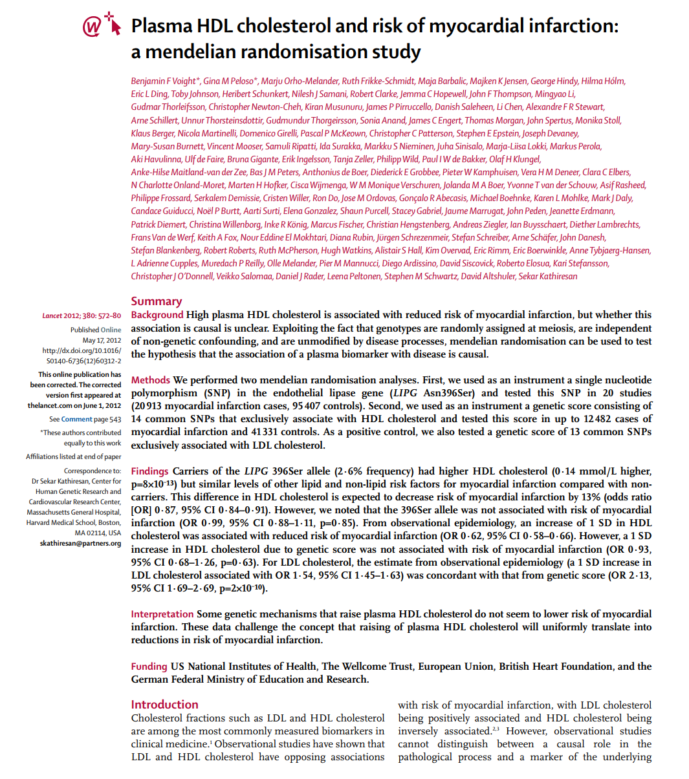
HDL Study https://www.sciencedirect.com/science/article/pii/S0140673612603122
Single SNP that associates with HDL

Slide 13
HDL Study
Three trials with HDL raising drugs were being conducted
2 stopped after this publication
1 finished and reached the same conclusions as the MR study

Slide 14
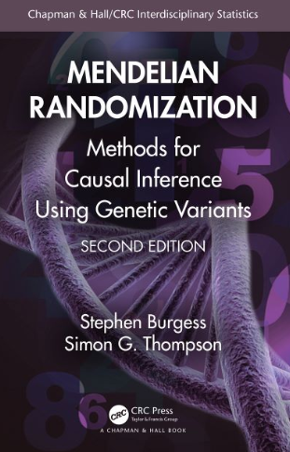
Summary of history
Vast literature
Looks simple, but there are plenty of problems that can come up
More on that later
Stephen Burgess has been pivotal in this field
2nd edition of book out last year
https://www.mendelianrandomization.com/index.php/book-chapters

Slide 15
MR Assumptions

Slide 16
Mendelian randomization assumptions
Relevance:
The sequence variant is robustly associated with the exposure
Confounders
Sequence
variant
Exposure
Outcome

Slide 17
Mendelian randomization
The sequence variant does not associate with confounders
Confounders
Sequence
variant
Outcome
Exposure

Slide 18
Mendelian randomization
No horizontal pleiotropy:
The effect of the sequence variant on the outcome is mediated through the exposure
Confounders
Sequence
variant
Exposure
Outcome

Slide 19
Can we validate these?
Smoking quantity
Does the effect go completely through the exposure?
Does the variant have an independent effect?
Case with BMI and T2D
Reverse causality

Slide 20
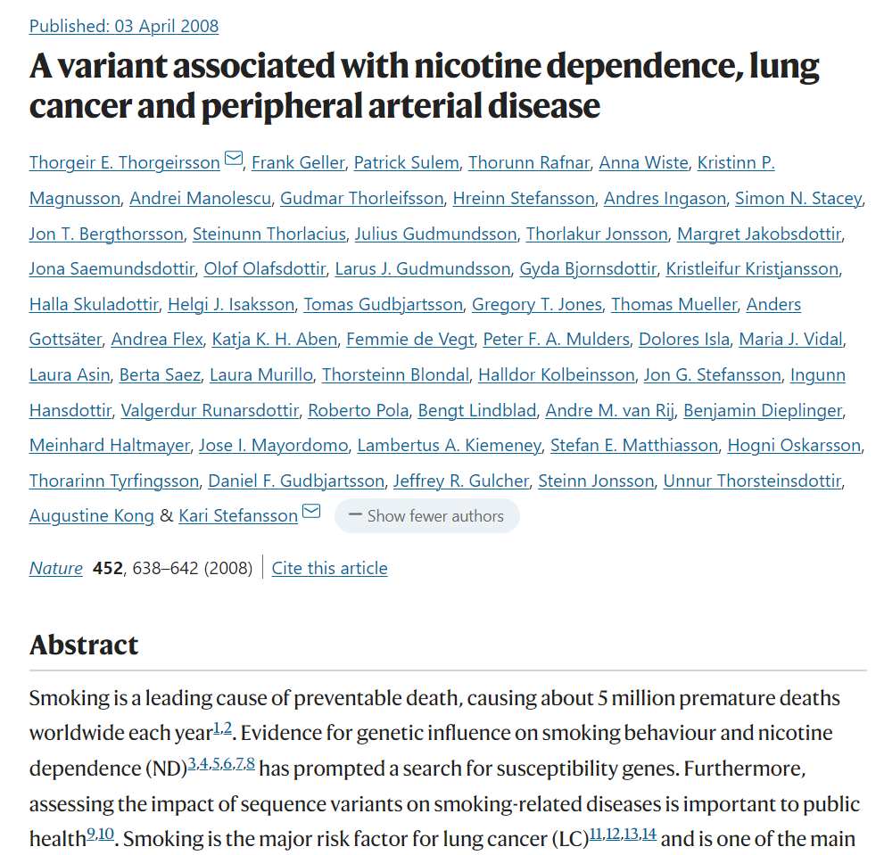
Mediation examples Smoking, single variant
Variant associates with smoking quantity
Also associates with lung cancer and PAD
The lung cancer and PAD associations are not fully mediated when adjusted for smoke quantity
Smoking quantity reported in a single questionnaire does not accurately capture smoking behavior
A lack of information in the phenotype is a more reasonable explanation than an independent pleiotropic effect

Slide 21
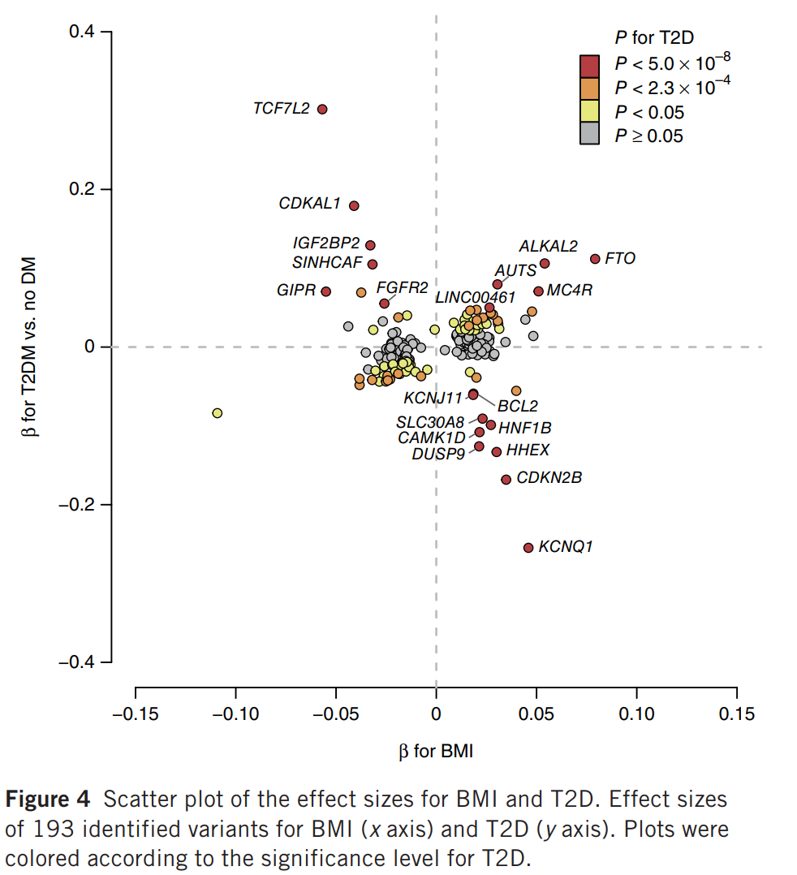
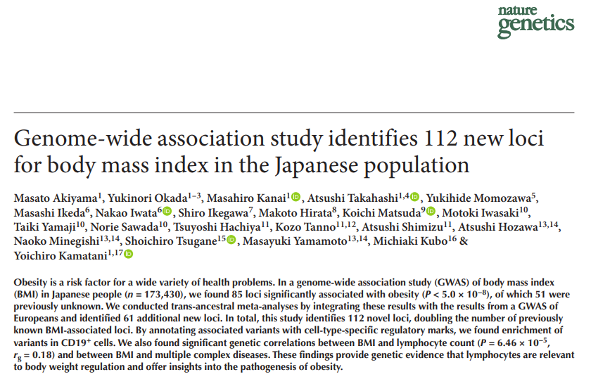
Bidirectional Relationship BMI <-> T2D
2017 Japanese GWAS on BMI
Strong T2D variants show a dose-response pattern where increased T2D risk associates with lower BMI
These are likely BMI instruments that are not going though BMI, but rather associations that represent consequence of disease

Slide 22
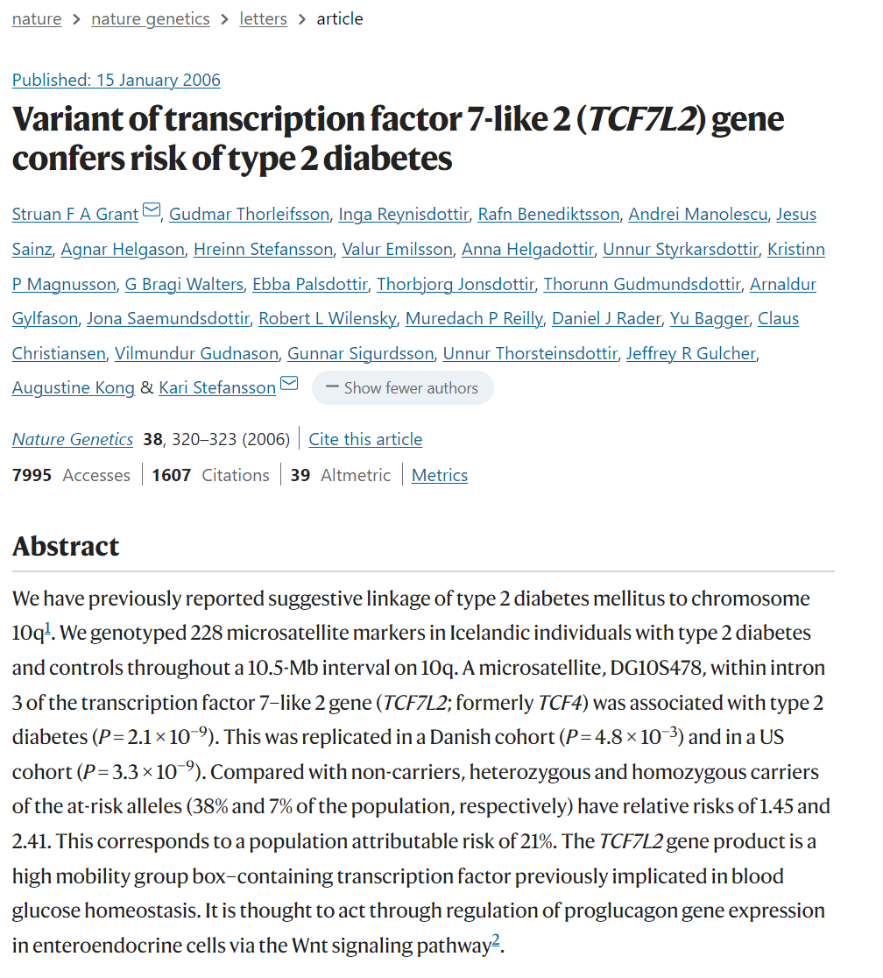
TCF7L2 case
TCF7L2 was discovered in the linkage era pre-gwas
Author‘s of the discovery manuscript specifically investigated associations with BMI
No association detected with the sample size
Conclusion: BMI is not on the causal pathway to T2D from this variant
Untreated T2D causes weight loss
Metformin causes slight weight loss

Slide 23
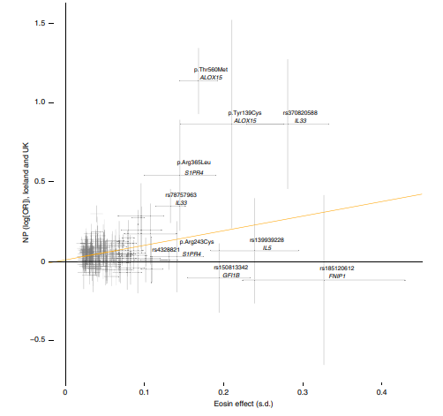
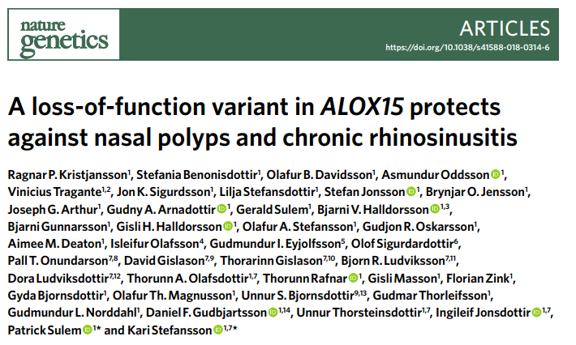
Does a significant regression slope imply causality?

Slide 24
MR versus other methods

Slide 25
MR versus experiment
We need to know about causes
RCT is the gold standard
Plethora of relationships that cannot be tested

Slide 26
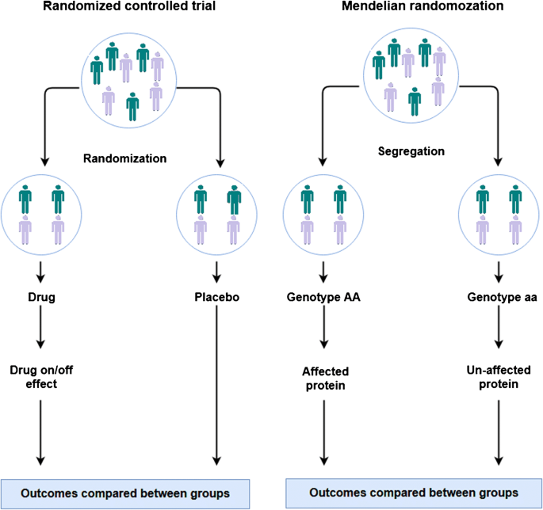
MR versus experiment
What if we want to know the effect of MDD on CVD?
Genotype as instrument to capture the exposure

Slide 27
The model

Slide 28
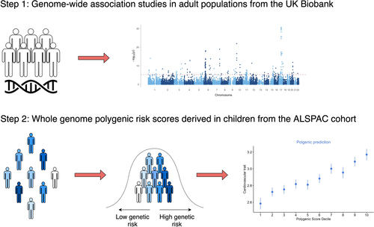
MR versus PRS
Polygenic risk score
Strict clumping (R² < .001, 1 000 kb)
Instrumental variable analysis

Slide 29
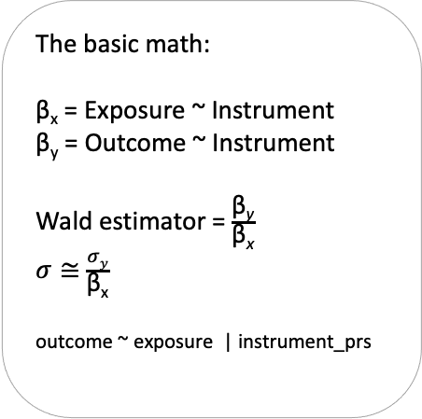
MR versus PRS
The basic math:
β_{x} = Exposure ~ Instrument
β_{y} = Outcome ~ Instrument
Wald estimator = $\frac{\text{β}\text{y}}{\text{β}\text{x}}$
$σ≅$ $\frac{σy}{\text{β}\text{x}}$
outcome ~ exposure | instrument_prs
One-sample MR
GWAS
Same as PRS analysis
But now use Two-Stage Least Squares regression (2SLS)
Your sample

Slide 30
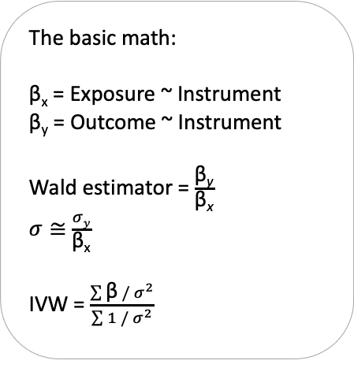
MR versus PRS
The basic math:
β_{x} = Exposure ~ Instrument
β_{y} = Outcome ~ Instrument
Wald estimator = $\frac{\text{β}\text{y}}{\text{β}\text{x}}$
$σ≅$ $\frac{σy}{\text{β}\text{x}}$
IVW = $\frac{\sum{\text{β} /{ σ}^{2}}}{\sum{1 /{ σ}^{2}}}$
Use GWAS summary statistics to capture the outcome
Harmonize
For each SNP, compute effect ratio
Weighted average of SNP effects
Two-sample MR
GWAS 1
GWAS 2

Slide 31
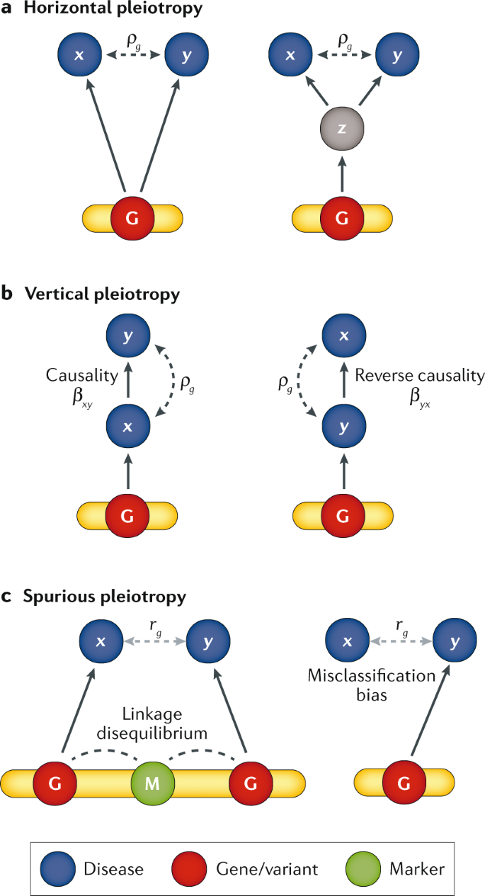
MR versus genetic correlations
The interpretation of r_{g}
Genome-wide versus top variants
https://www.nature.com/articles/s41576-019-0137-z

Slide 32
Controversy
Ancestry, assortative mating, no known biological effect
The assumptions of MR can never be met
Methodological rigour, statistical tricks

Slide 33
Preparation
https://github.com/gumeo/NSHG2023_MRworkshop
Wifi Swissotel_Meeting, password events
Download repository: git clone https://github.com/gumeo/NSHG2023_MRworkshop.git
Open NSHG2023_MRworkshop.Rproj
source ("analysis/step_0_prepwork.R")
Most importantly run the last line to download the sumstats (~5Gb)

